Slide 1
Red Black Trees
Binary search tree.
Height Balanced trees.
At the most 2 rotations required to balance the tree or only re-colouring is required to balance the tree.
O(log ₂n) for search/insert/delete operations.
Notes:
Actually, red-black search trees. Every red node has a black parent.

Slide 2
Example Red-Black Tree
10
7
40
45
3
8
30
35
60
1
5
20
25
Notes:
Height = 5, red nodes have red edges coming into them from their parent and black nodes have black edges coming in

Slide 3
Red Black Trees
Colored Nodes Definition
Each node is colored red or black.
Root and all external nodes are black.
No root-to-external-node path has two consecutive red nodes.
All root-to-external-node paths have the same number of black nodes
Red node has both children black
Black node can have either color children
AVL trees are subset of RED BLACK trees
Notes:
Actually, red-black search trees. Every red node has a black parent.

Slide 4
Red Black Trees
Colored Nodes Definition
Each node is colored red or black.
Root and all external nodes are black.
No root-to-external-node path has two consecutive red nodes.
All root-to-external-node paths have the same number of black nodes
Red node has both children black
Black node can have either color children
AVL trees are subset of RED BLACK trees
10
7
40
3
8
30
45
35
60
1
5
20
25
Notes:
Actually, red-black search trees. Every red node has a black parent.

Slide 5
Properties
The height of a red black tree that has n (internal) nodes is between log₂(n+1) and 2log₂(n+1).

Slide 6
Properties
Start with a red black tree whose height is h; collapse all red nodes into their parent black nodes to get a tree whose node-degrees are between 2 and 4, height is >= h/2, and all external nodes are at the same level.

Slide 7
Properties
10
7
40
45
3
8
30
35
60
1
5
20
25
Notes:
Collapsed height = 3.

Slide 8
Properties
Let h’ ≥ h/2 be the height of the collapsed tree.
Internal nodes of collapsed tree have degree between 2 and 4.
Number of internal nodes in collapsed tree ≥ 2^{h’}-1.
So, n ≥ 2^{h’}-1
So, h ≤ 2 log₂ (n + 1)

Slide 9
Properties
At most 1 rotation and O(log n) color flips per insert/delete.
Priority search trees.
  Two keys per element.
  Search tree on one key, priority queue on other.
  Color flip doesn’t disturb priority queue property.
  Rotation disturbs priority queue property.
  O(log n) fix time per rotation => O(log²n) overall time for AVL.
Notes:
Color flip to be defined later.
Binary search trees in which each node contains a binary search tree are used, for example, in some IP router table data structures. Each rotation of the outer binary search tree requires changes in the binary search trees of the involved nodes resulting in an O(log n) cost per rotation. The stated O(log²n) time is for AVL trees.

Slide 10
Properties
Every AVL tree is a red-black tree.
A binary tree is red-black iff for every node x, the length of the longest path from x to an external node in its subtree is at most twice that of the shortest.
O(1) amortized complexity to restructure following an insert/delete.
C++ STL implementation
java.util.TreeMap => red-black tree
Notes:
The delete operation in an AVL tree does O(log n) rotations in the amortized sense (https://arxiv.org/pdf/1506.03528.pdf). So, the cost of the restructuring required for a sequence of n inserts/deletes in an AVL tree is O(n log n). If you do only inserts, this cost is O(n) (https://arxiv.org/pdf/1506.03528.pdf).
Every AVL tree is a red-black tree (see https://stackoverflow.com/questions/34236842/convert-avl-trees-to-red-black-tree for a coloring algorithm for AVL trees).
Actually, every binary tree in which the length of the longest root to external node path from every node is at most twice that of the shortest such path from that node is red-black (see https://cs.stackexchange.com/questions/10990/colour-a-binary-tree-to-be-a-red-black-tree for a coloring algorithm).

Slide 11
Insert
Every new node must be inserted with RED color.
The insertion operation in Red Black Tree is similar to insertion operation in Binary Search Tree.
After every insertion operation, we need to check all the properties of Red-Black Tree.

Slide 12
following operation to make it Red Black Tree.
1. Recolor
2. Rotation
3. Rotation followed by Recolor

Slide 13
insert - algo
Step 1 - Check whether tree is Empty.
Step 2 - If tree is Empty then insert the newNode as Root node with color Black and exit from the operation.
Step 3 - If tree is not Empty then insert the newNode as leaf node with color Red.
Step 4 - If the parent of newNode is Black then exit from the operation.

Slide 14
Step 5 -. If the parent of newNode is Red then check the color of parent node's sibling/Uncle of newNode.
Step 6 - If uncle is colored Black or NULL then make suitable Rotation and Recolor( p-nn and g-nn)
Step 7 - If it is colored Red then perform Recolor(p-nn and u-nn only). Repeat the same until tree becomes Red Black Tree

Slide 15
Example
Create a Red-Black Tree of following numbers
8, 18, 5, 15, 17, 25, 40, 80

Slide 16
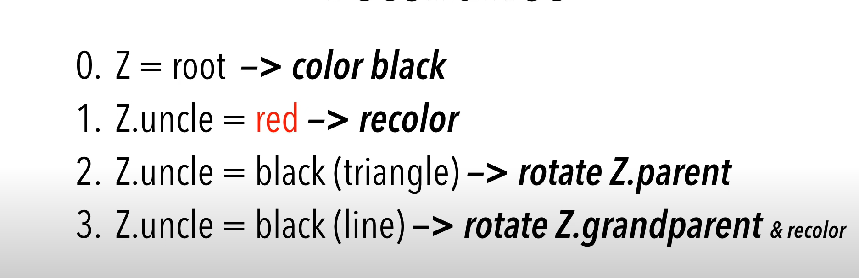

Slide 17
Properties of Red-Black Trees
Every node is either red or black.
The root is black.
Every leaf (NIL) is black.
If a node is red, then both its children are black.
For each node, all simple paths from the node to descendant leaves contain the same number of black nodes.

Slide 18
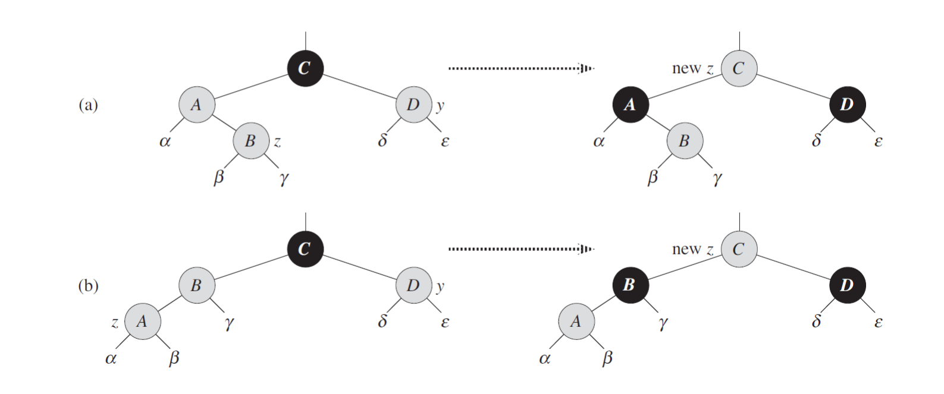
Case 1: new nodes parent and uncle both are red
recolor parent and uncle
move nn pointer to grandparent
  if current nn is root – color it black
  else color is red
repeat a and b till we reach null

Slide 19
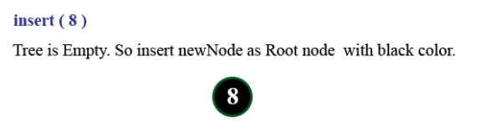

Slide 20
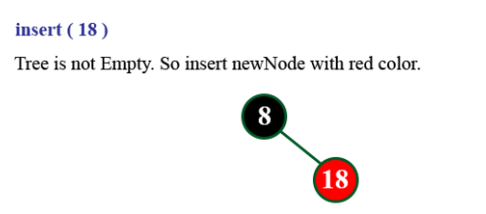

Slide 21
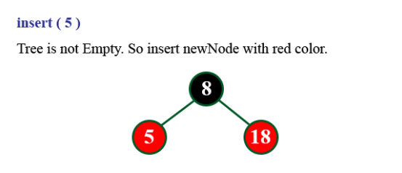

Slide 22
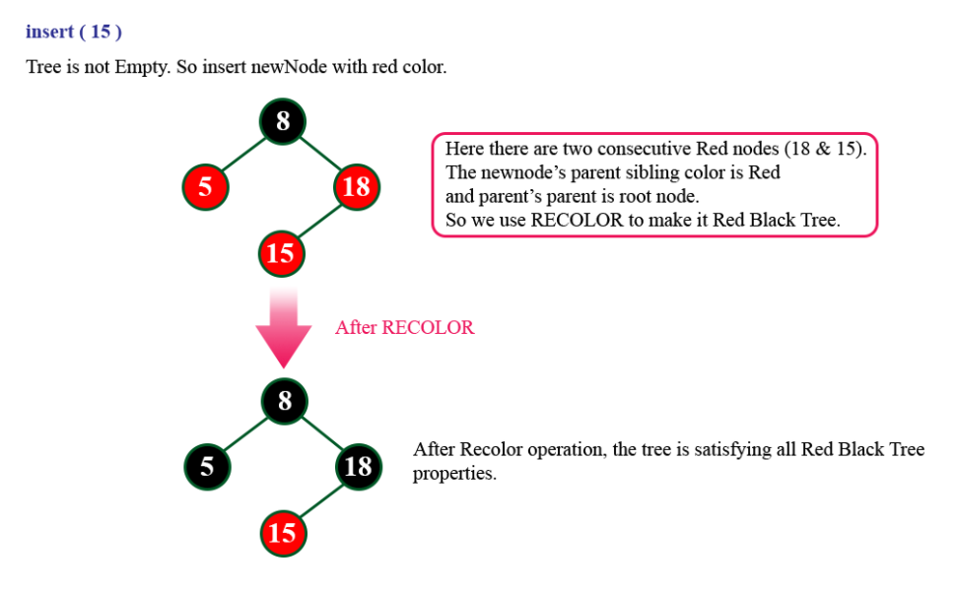

Slide 23
Case 2 and 3
In cases 2 and 3, the color of nn’s uncle y is black.
if nn is a right child -> Case 2
if nn is left child -> Case 3
if Case 2: We immediately use a left rotation to transform the situation into case 3

Slide 24
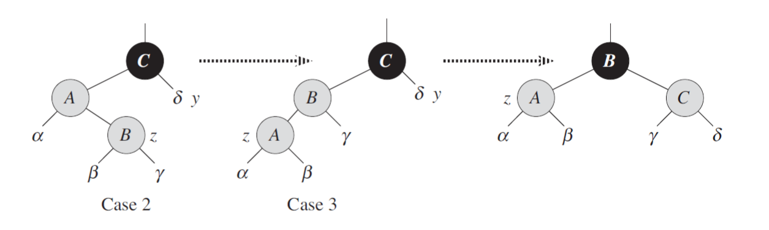
Case 2: nn’s uncle y is black and nn is right child
Case 3: nn’s uncle y is black and n is left child

Slide 25
Case 2 –> Case 3
makes nn´ point to nn’s p, which is red. No further change to nn or its color occurs in cases 2 and 3.
b. Case 3 makes nn’s p is black, so that if ´:p is the root at the start of the next iteration, it is black.
c.

Slide 26
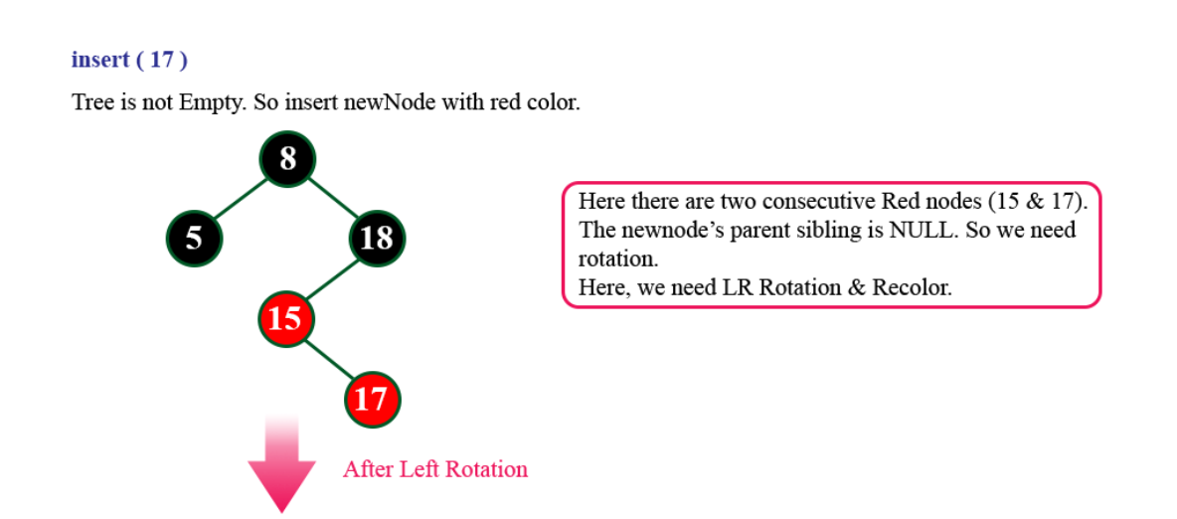
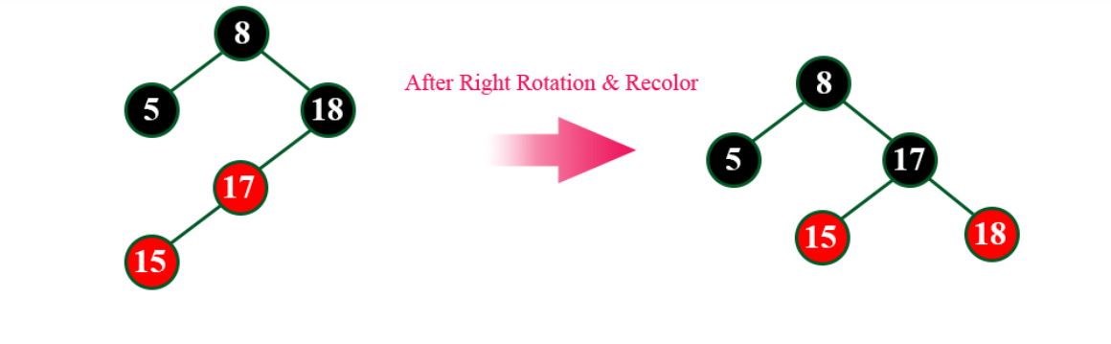

Slide 27
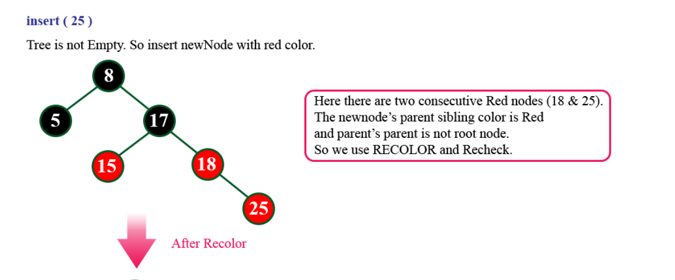
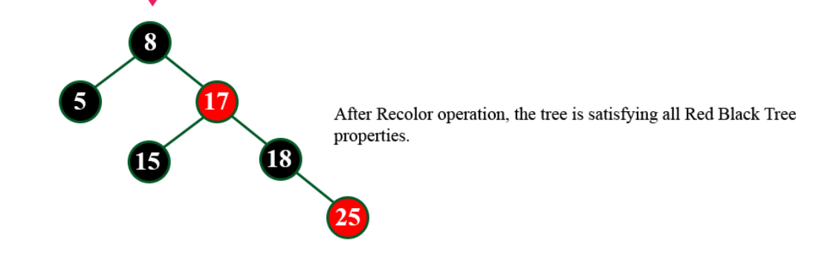

Slide 28
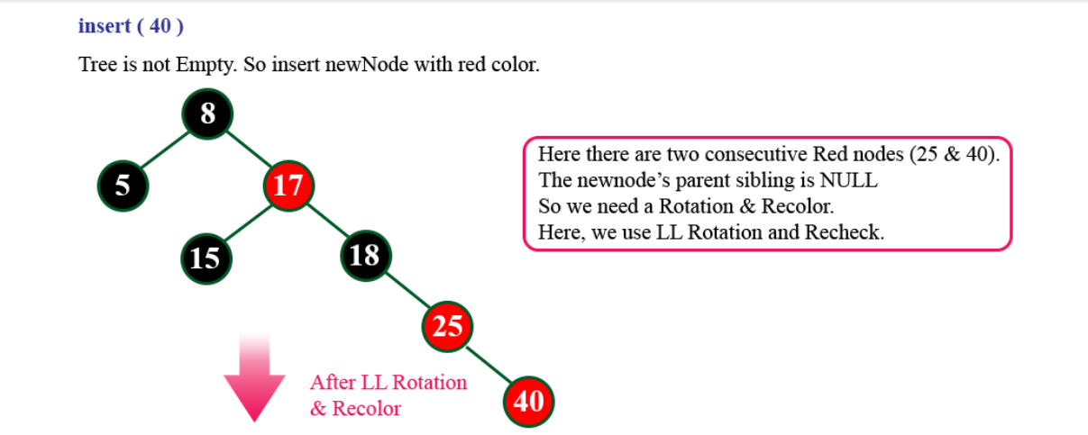
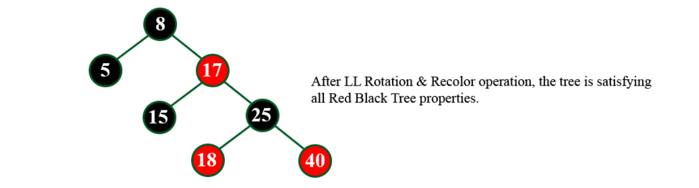

Slide 29
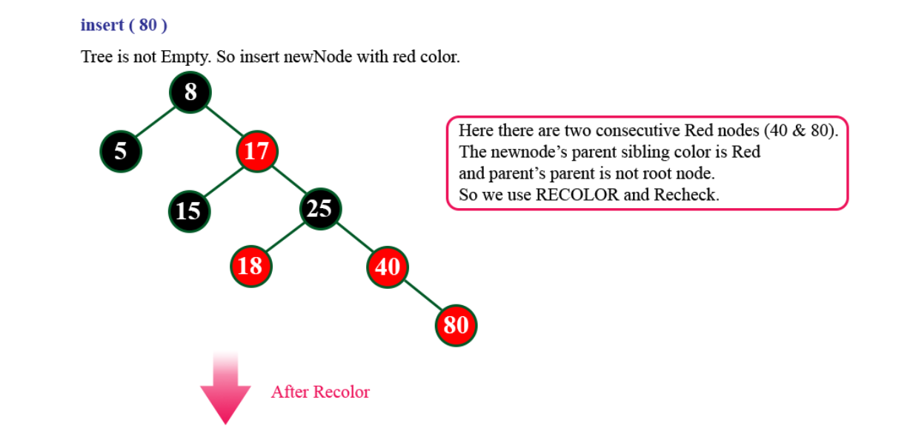
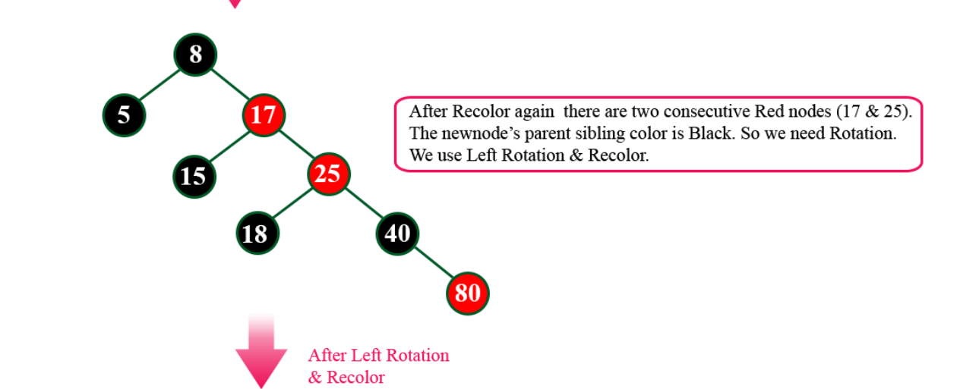

Slide 30
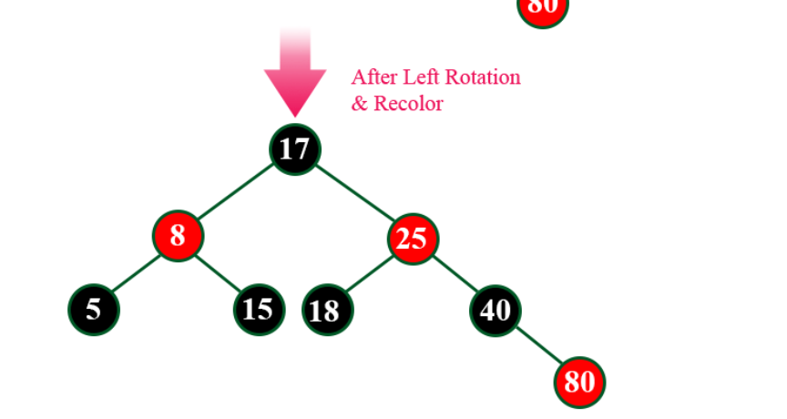

Slide 31
Insert
New pair is placed in a new node, which is inserted into the red-black tree.
New node color options.
  Black node => one root-to-external-node path has an extra black node (black pointer).
    Hard to remedy.
  Red node => one root-to-external-node path may have two consecutive red nodes (pointers).
    May be remedied by color flips and/or a rotation.

Slide 32
Insert
If tree is empty color the node black else color the new node as red.
if parent of new node is black then return
if parent of new node is red, then check color of uncle:
a)uncle is black – rotate and re-colour
b) uncle is red – recolor parent and uncle
grandparent is not root node

Slide 33
https://www.programiz.com/dsa/insertion-in-a-red-black-tree

Slide 34
Classification Of 2 Red Nodes/Pointers
gp
pp
d
p
c
XYz
  X => relationship between gp and pp.
    pp left child of gp => X = L.
  Y => relationship between pp and p.
    p left child of pp => Y = L.
  z = b (black) if d = null or a black node.
  z = r (red) if d is a red node.
a
b
Notes:
Pp cannot be root as root is black
Initially, p is newly inserted node. Pp and gp may be null. In each round, p, pp, and gp are moved up by 2 levels.
If p is a red root, make it black.
If p or pp black done!
If pp is a red root, make it black.
O.w., gp exists

Slide 35
XYr
Color flip.
gp
gp
pp
pp
d
d
p
p
c
c
a
b
a
b
Move p, pp, and gp up two levels.
Continue rebalancing.

Slide 36
LLb
Rotate.
gp
y
z
pp
x
y
z
d
p
x
a
b
c
d
c
a
b
Done!
Same as LL rotation of AVL tree.

Slide 37
LRb
Rotate.
gp
y
z
pp
x
x
z
d
a
p
a
b
c
d
y
b
c
Done!
Same as LR rotation of AVL tree.
RRb and RLb are symmetric.

Slide 38
Delete
Delete as for unbalanced binary search tree.
If red node deleted, no rebalancing needed.
If black node deleted, a subtree becomes one black pointer (node) deficient.
Notes:
Note the delete may create 2 red nodes in a sequence. But, this is taken care of by one of the following transformations→ y is red change to black.

Slide 39
Delete A Black Leaf
10
7
40
45
3
8
30
35
60
1
5
20
25
Delete 8.

Slide 40
Delete A Black Leaf
10
py
7
40
y
45
3
30
35
60
1
5
20
25
y is root of deficient subtree.
py is parent of y.
Notes:
If py doesn’t exist, the whole tree is one black node deficient. This is OK.

Slide 41
Delete A Black Degree 1 Node
10
py
7
40
45
3
8
30
y
35
60
1
5
20
25
Delete 45.
y is root of deficient subtree.
Notes:
Delete 20 yields 2 red nodes in a sequence with y being 25. Y is changed to black next resulting in a proper red-black tree.

Slide 42
Delete A Black Degree 2 Node
10
7
40
45
3
8
30
35
60
1
5
20
25
Not possible, degree 2 nodes are never deleted.

Slide 43
Rebalancing Strategy
If y is a red node, make it black.
10
py
7
40
45
3
8
30
y
35
60
1
5
20
25
Notes:
This also ensures we don’t have 2 red nodes in a sequence.

Slide 44
Rebalancing Strategy
Now, no subtree is deficient. Done!
10
py
7
40
45
3
8
30
y
35
60
1
5
20
25

Slide 45
Rebalancing Strategy
y is a black root (there is no py).
Entire tree is deficient. Done!
y
10
7
40
45
3
8
30
35
60
1
5
20
25

Slide 46
Rebalancing Strategy
y is black but not the root (there is a py).
py
v
y
a
b
Xcn
  y is right child of py => X = R.
  Pointer to v is black => c = b.
  v has 1 red child => n = 1.
Notes:
y represents both a subtree and its root.
This includes the case when y is null.
Broken lines indicate pointers whose colors are unspecified.
v must exist because y is one black node/pointer deficient.

Slide 47
Rb0 (case 1, py is black)
py
py
v
v
y
y
a
b
a
b
Color change.
Now, py is root of deficient subtree.
Continue!

Slide 48
Rb0 (case 2, py is red)
py
py
v
v
y
y
a
b
a
b
Color change.
Deficiency eliminated.
Done!

Slide 49
Rb1 (case 1)
v
py
py
v
a
y
b
y
a
b
LL rotation.
Deficiency eliminated.
Done!

Slide 50
Rb1 (case 2)
w
py
v
py
v
y
a
b
c
y
a
w
b
c
LR rotation.
Deficiency eliminated.
Done!

Slide 51
Rb2
w
py
v
py
v
y
a
b
c
y
a
w
b
c
LR rotation.
Deficiency eliminated.
Done!

Slide 52

Rr(n)
n = # of red children of v’s right child w.
py
v
y
Rr(2)
a
w
b
c

Slide 53
Rr(0)
v
py
py
v
a
y
b
y
a
b
LL rotation.
Done!

Slide 54
Rr(1) (case 1)
w
py
v
py
v
y
a
b
c
y
a
w
b
c
LR rotation.
Deficiency eliminated.
Done!

Slide 55
Rr(1) (case 2)
x
py
v
py
v
y
a
d
y
a
w
w
b
x
b
c
Rotation.
Deficiency eliminated.
Done!
c
d

Slide 56
Rr(2)
x
py
v
py
v
y
a
d
y
a
w
w
b
x
b
c
Rotation.
Deficiency eliminated.
Done!
c
d

Slide 57
THE END

Slide 58
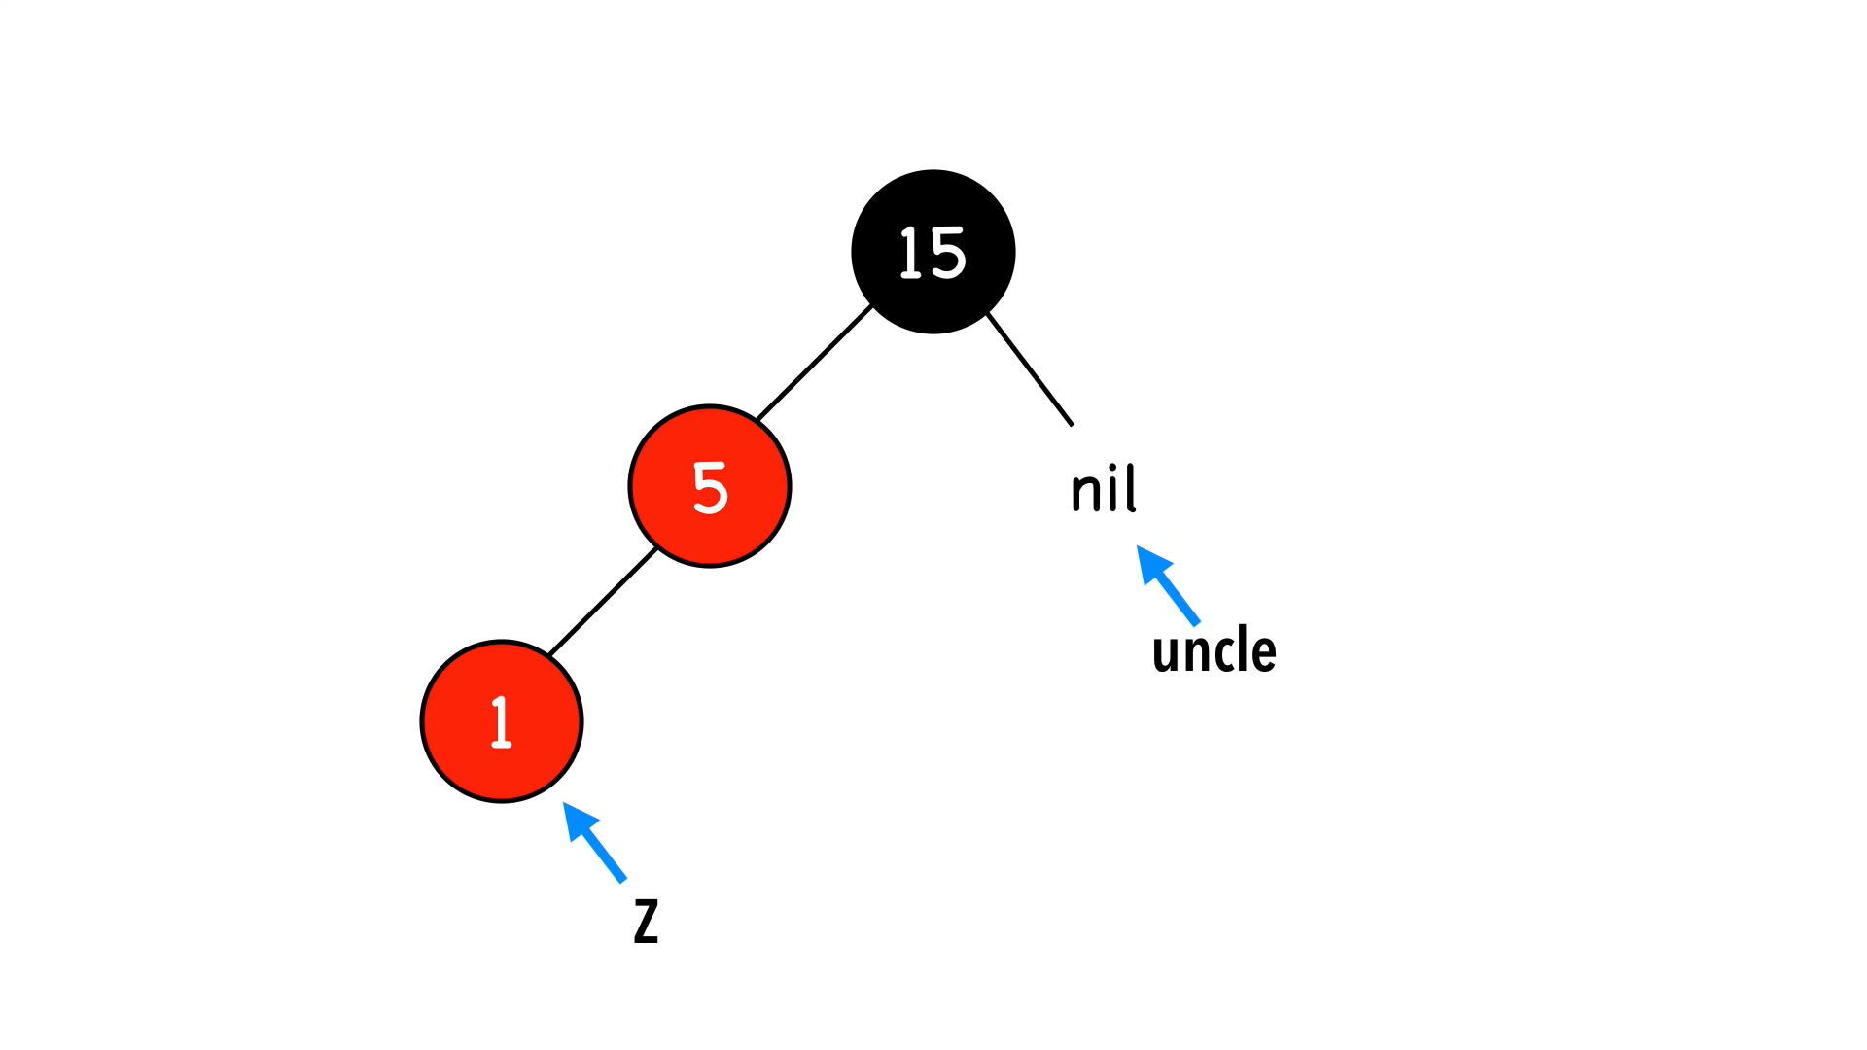

Slide 59
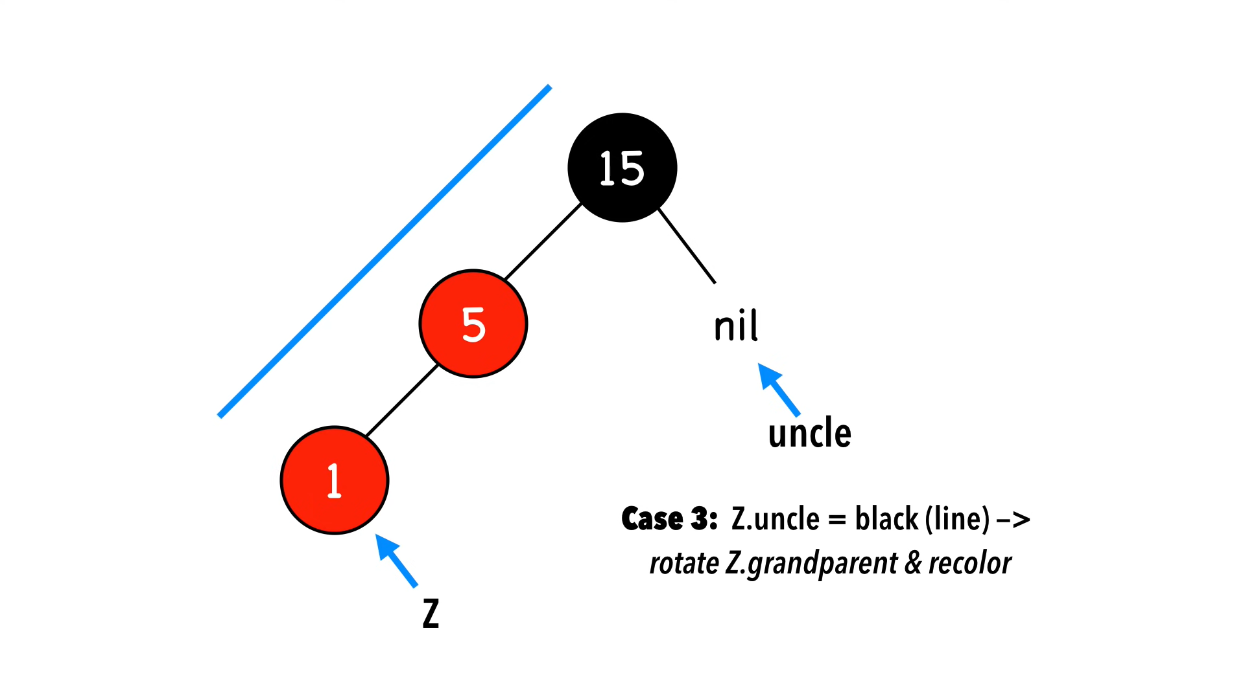

Slide 60
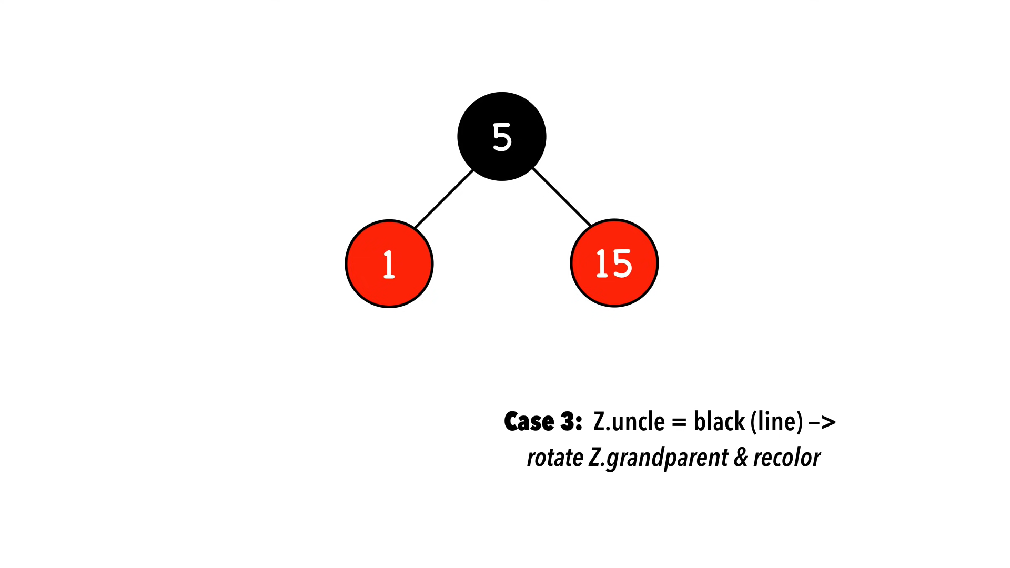

Slide 61
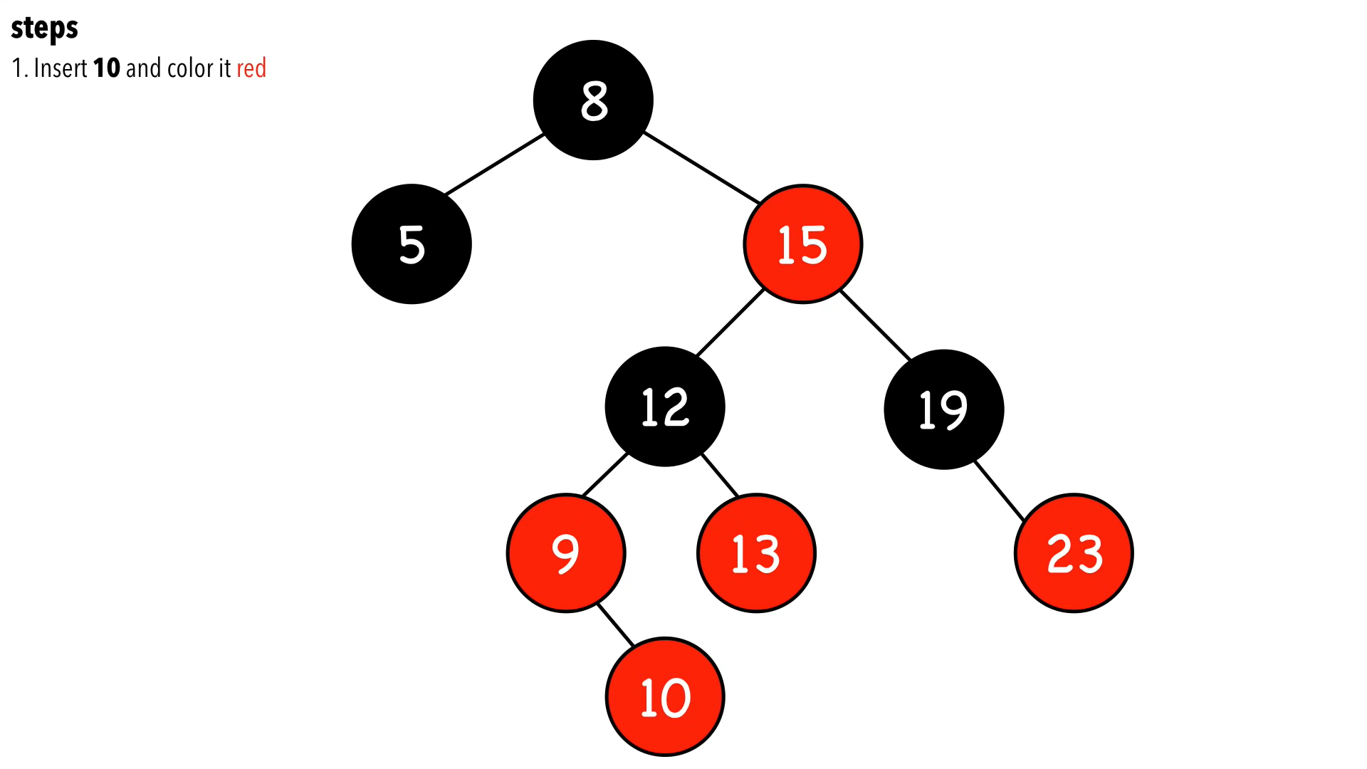

Slide 62
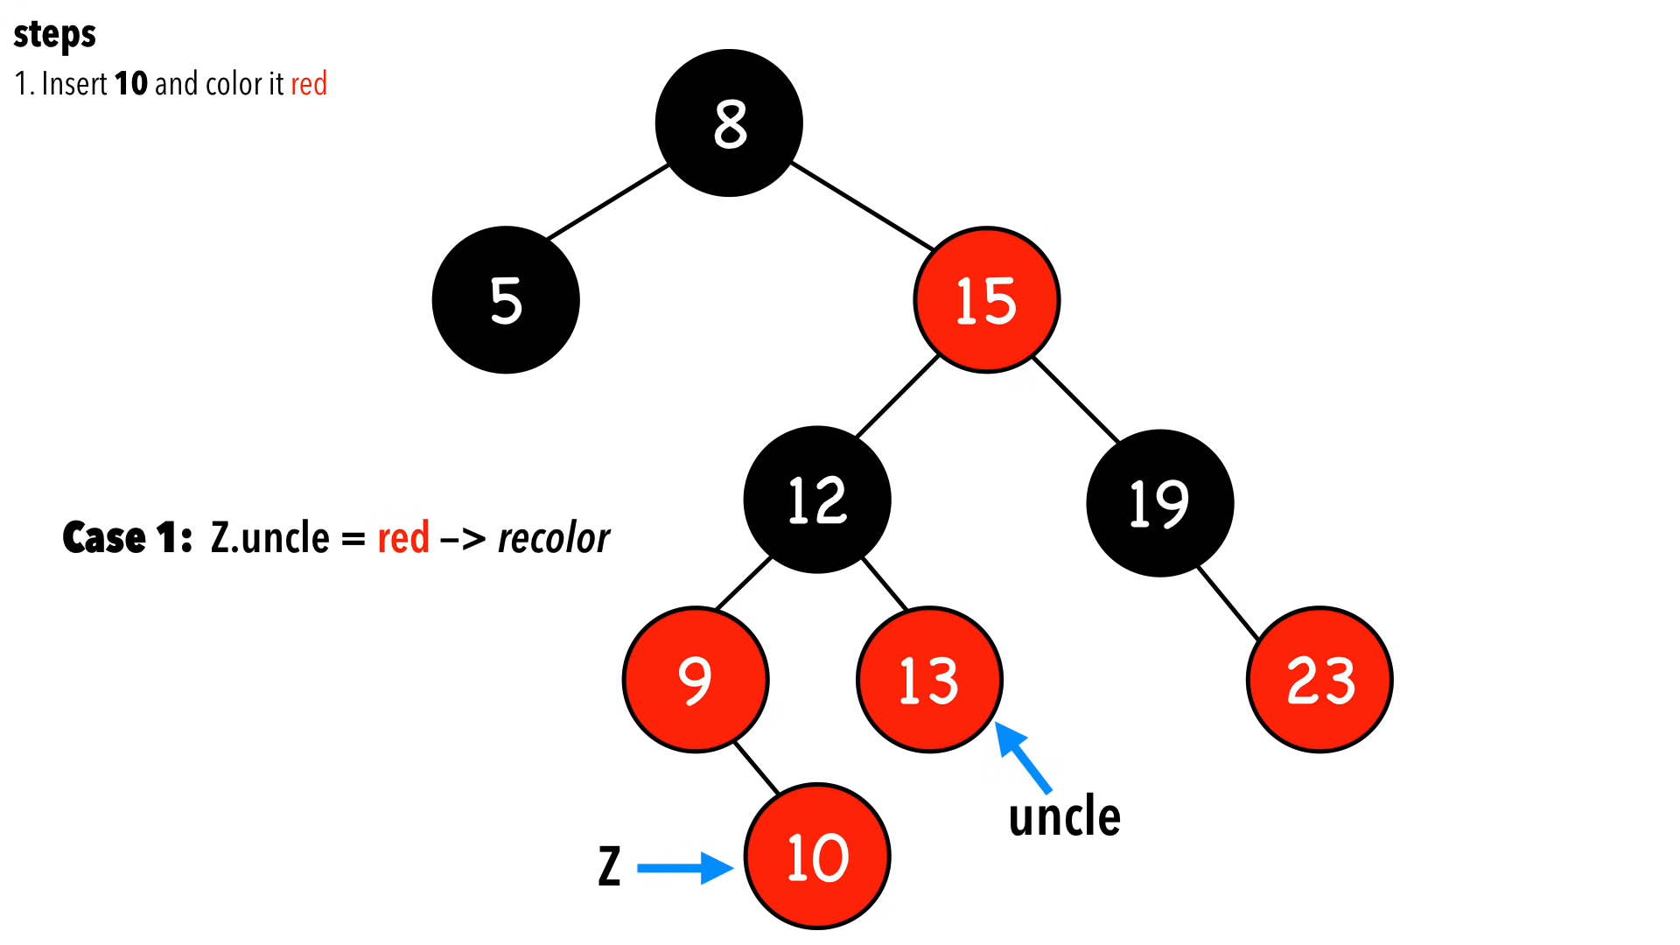

Slide 63
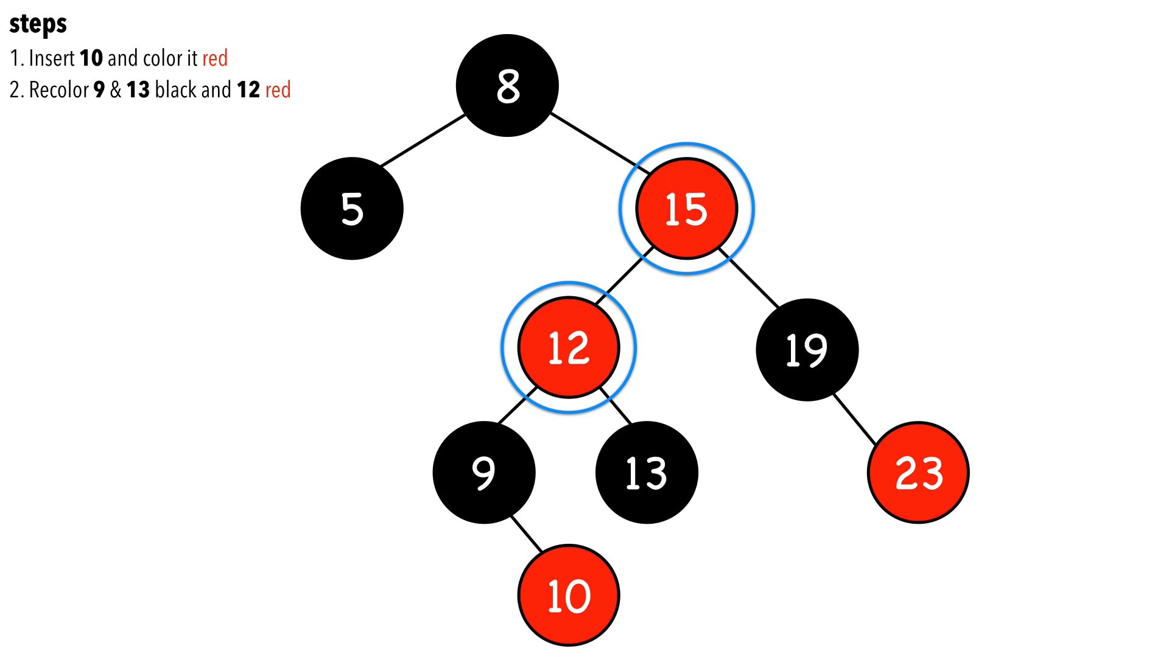

Slide 64
